Slide 1
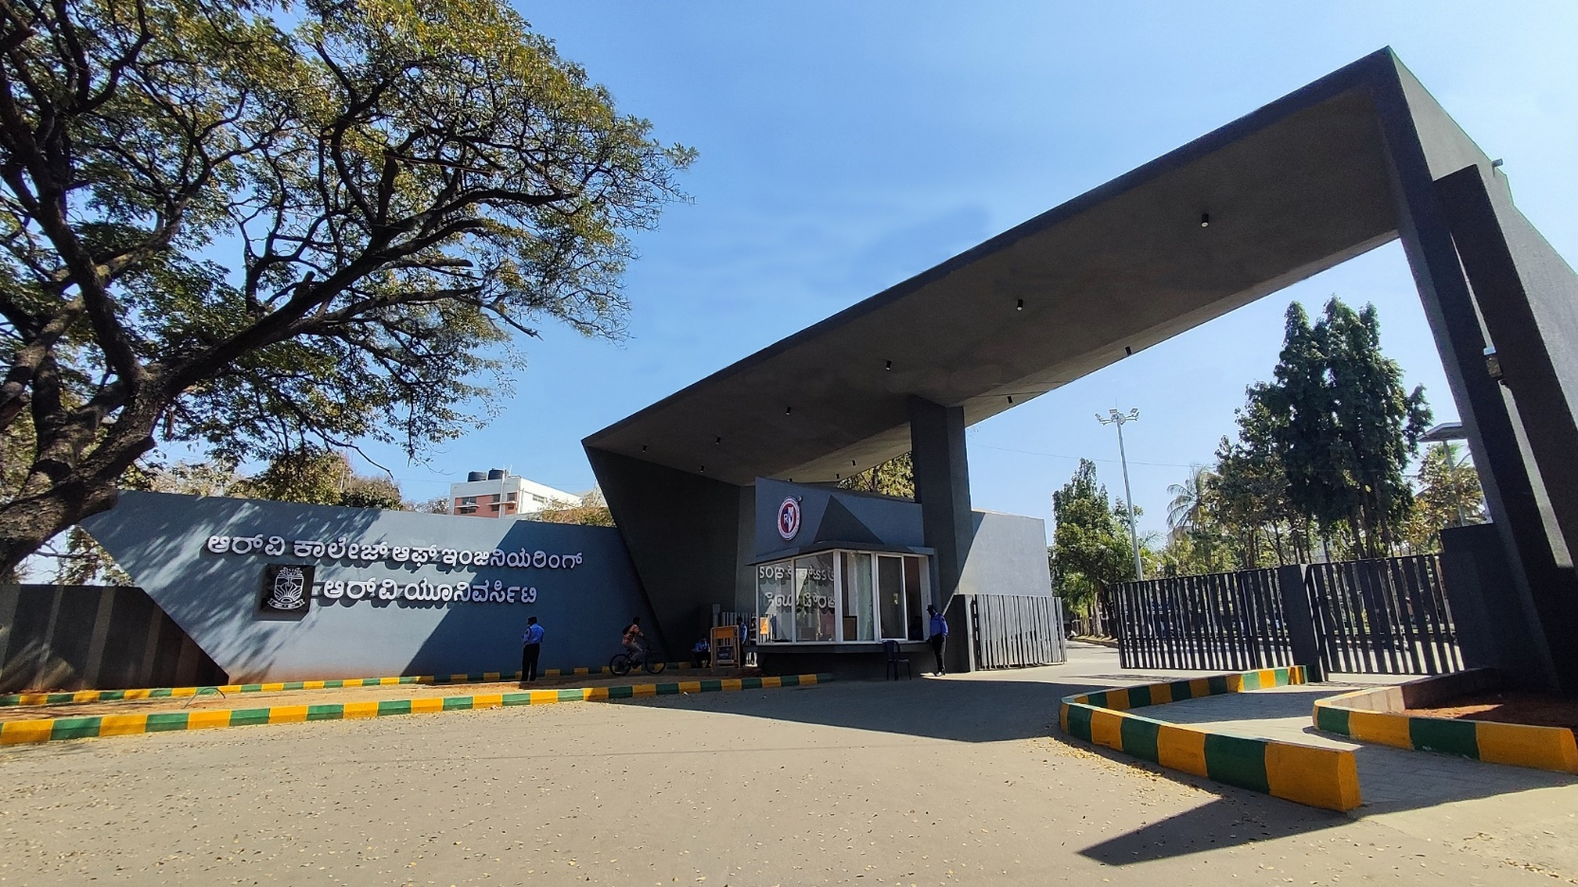
Decentralizing energy networks: Blockchain model for smart grid energy trading
Theme: Energy
Group no: 81

Slide 2




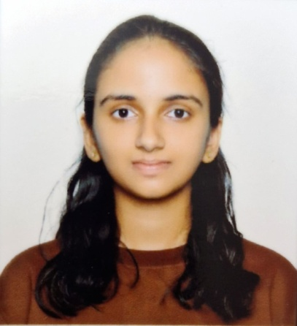

Decentralizing energy networks: Blockchain innovations for smart grid energy trading
Anwesha Mohapatra
Dummu Nishitha
Deepana V
Dr Shanmukha Nagaraj
Dean Academics
Mechanical
Himpana S S Sivani Vemuri

Slide 3
EL Phase-II
Presentation Outline
Introduction
Project Overview
Comments during EL Phase-I and action taken.
Tools and Techniques Used
Project Progress
Analysis of Partial Results
Deliverables and Outcomes
Future work (Remaining tasks)
Conclusion

Slide 4

Introduction
Overview of the topic:
Decentralization of smart grids through a Peer-to-Peer (P2P) blockchain model allows individuals to produce, consume, and trade energy directly, bypassing traditional utilities. Blockchain ensures secure, transparent transactions in these decentralized networks, promoting efficiency and real-time energy trading. This approach enhances grid resilience, supports renewable energy integration, reduces energy costs, and fosters energy independence by enabling local energy markets.
Enhancing Transaction Efficiency: Streamlining energy transactions through secure, transparent, and automated processes on the blockchain to reduce costs and time delays.
Supporting Renewable Energy Integration: Facilitating efficient energy trading among prosumers (producers and consumers) of renewable energy, enhancing grid sustainability.

Slide 5
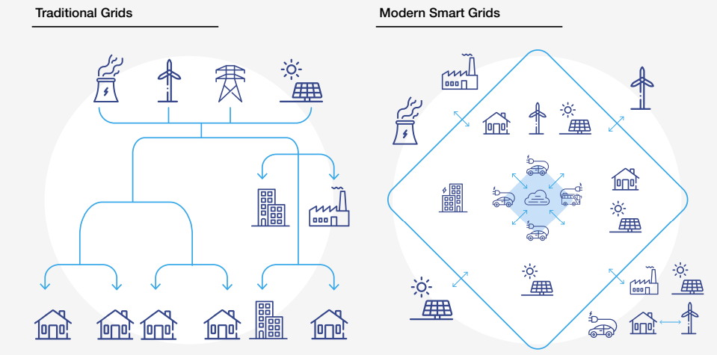
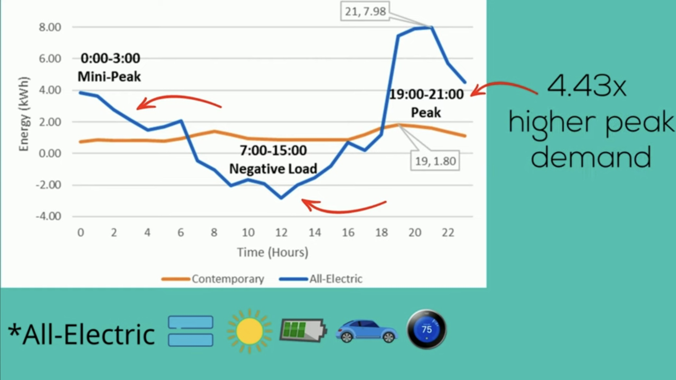
Project Overview
Context of the Problem:
shift to renewable energy sources like solar power, with rise of electric vehicles (EVs) and energy storage systems, poses challenges for existing electrical grid infrastructure. Key factors contributing to inefficiencies and energy losses include:
Intermittency: Solar energy generation varies with weather and time of day, creating supply gaps that make it hard to meet consumer demand.
Traditional Grid Inflexibility: Many grids are designed for centralized energy sources, lacking the flexibility needed for decentralized, variable inputs.
Inadequate Infrastructure: Current systems often cannot handle the bidirectional flow of electricity, leading to congestion and reliability issues.
Limited Real-Time Data: Without advanced monitoring, grid operators struggle to respond effectively to supply and demand changes.
Regulatory Barriers: Traditional energy markets may not support innovative solutions like decentralized trading and energy storage.

Slide 6
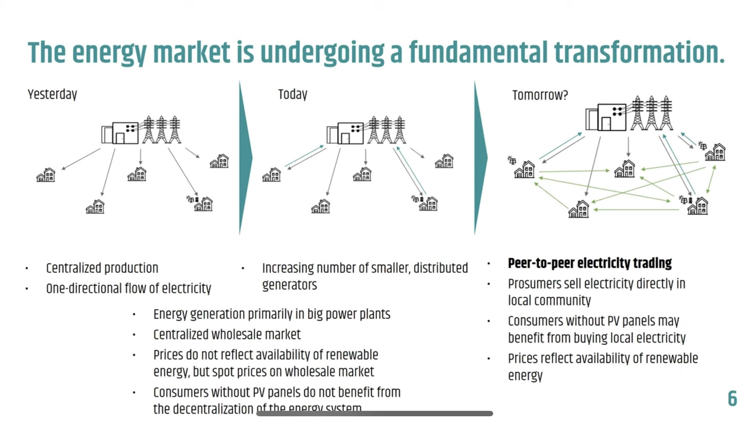

Slide 7
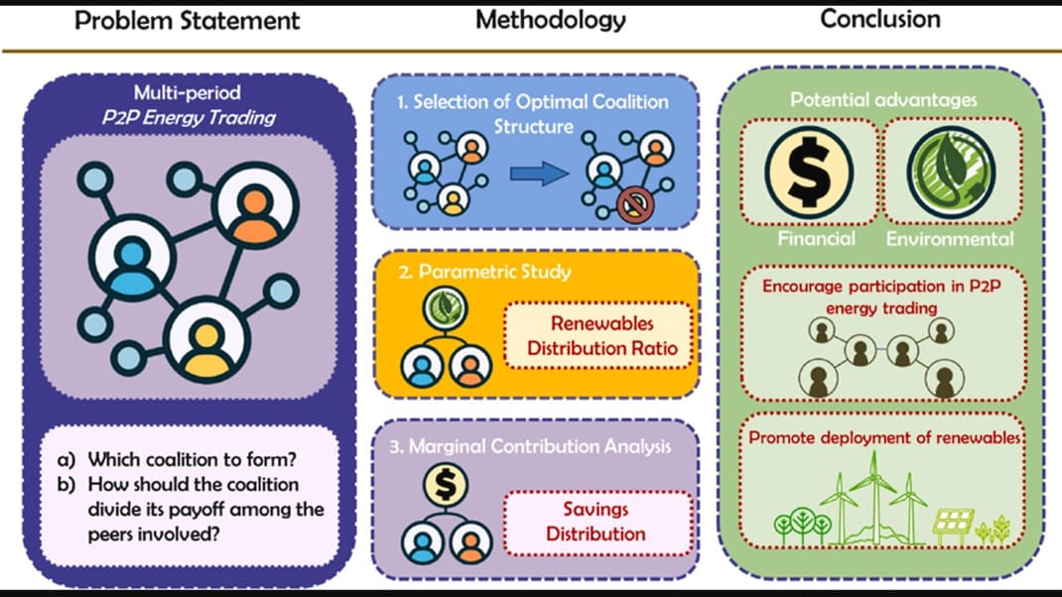

Slide 8
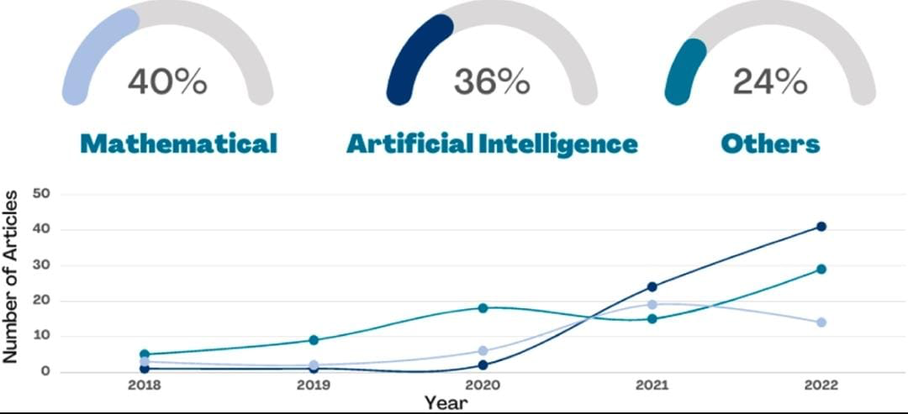

Slide 9
The integration of blockchain models in smart grids is expected to:
Increase Efficiency: Streamline transactions, reducing costs and delays in energy trading.
Enhance Security and Transparency: Provide secure, tamper-proof transaction records, fostering trust.
Enable Decentralized Energy Markets: Empower peer-to-peer trading, reducing reliance on utilities.
Improve Grid Resilience: Increase flexibility, helping the grid adapt to supply and demand fluctuations.
Optimize Renewable Energy Use: Facilitate efficient integration and trading of renewable energy.
Reduce Costs: Lower operational expenses by eliminating intermediaries.
These outcomes contribute to more efficient, sustainable, and resilient energy systems.
Expected impact or contribution of the project

Slide 10
Summary of feedback received in phase-I :
Requirement for more concise and precise slide presentation.
Survey regarding current scenario as compared to previous scenario in the field of blockchain integration for energy trading in smart grids.
Improved understanding on need for blockchain in smart grids.
Actions taken in Phase-II to address those comments or feedback:
Improved quality of slides by ensuring precise and more visual representation.
Thorough research, analysing past and current scenario.
Comments during EL Phase-I and action taken

Slide 11
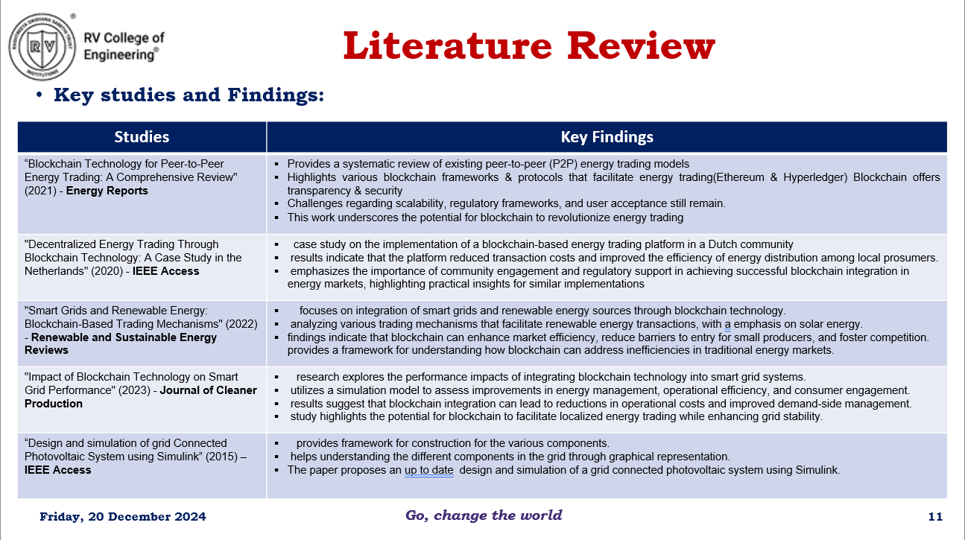

Slide 12
Tools and techniques used
TOOLS | FUNCTIONALITY
Kaleido | Used to create and manage the blockchain network.
Solidity | Programming language for writing smart contracts.
Truffle Suite | A development environment for testing and deploying smart contracts
Web3.js | A JavaScript library for interacting with the Ethereum blockchain
IPFS | For decentralized storage solutions

Slide 13
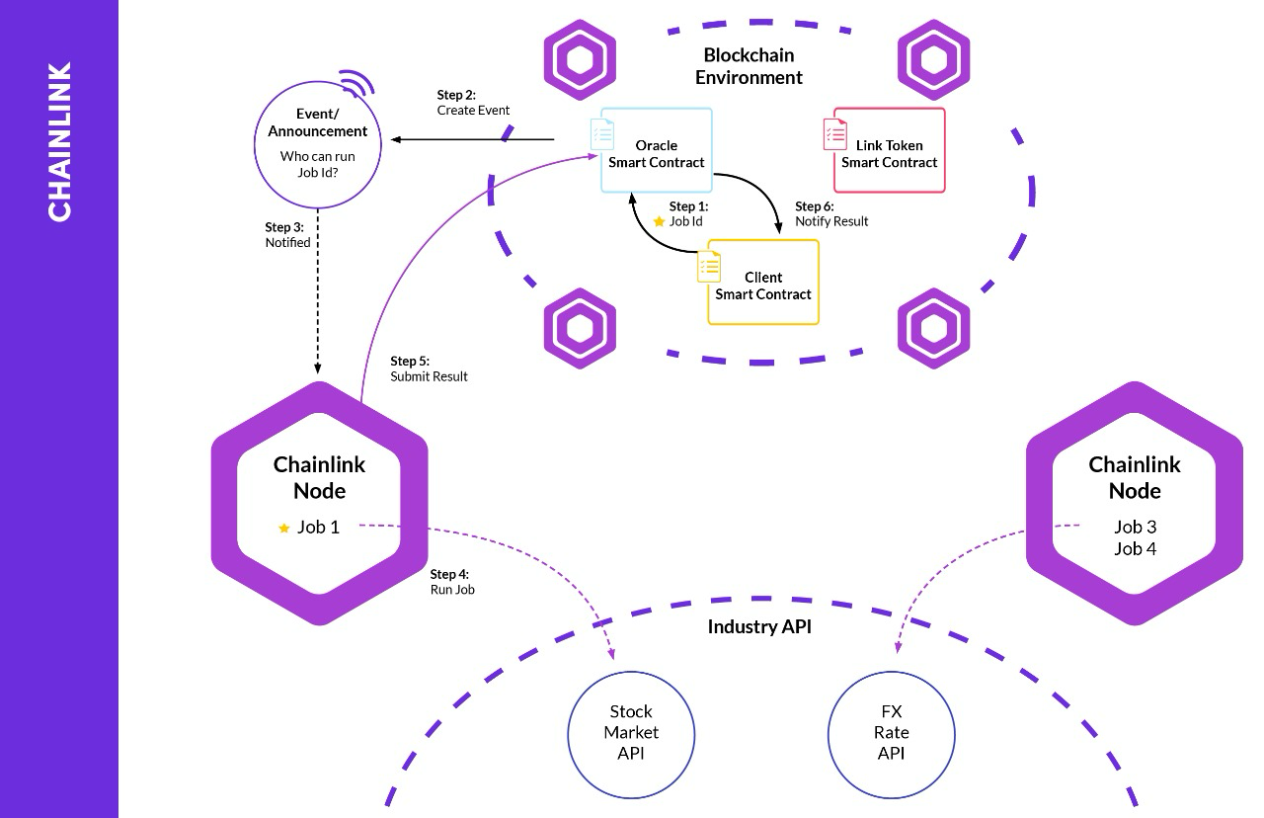
Chain-link

Slide 14
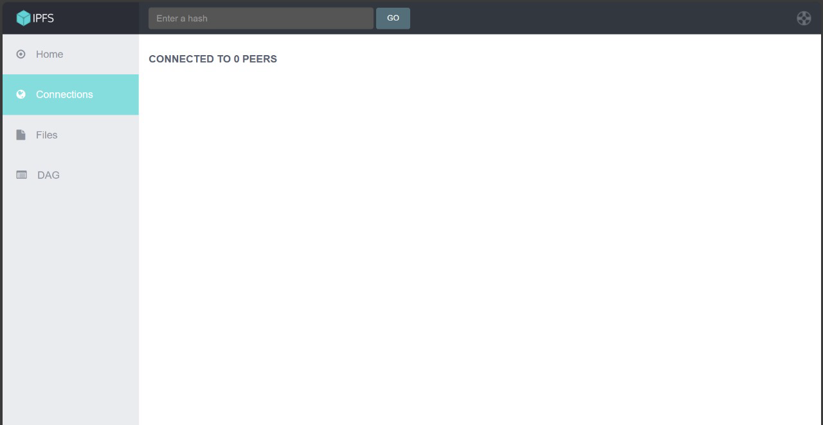
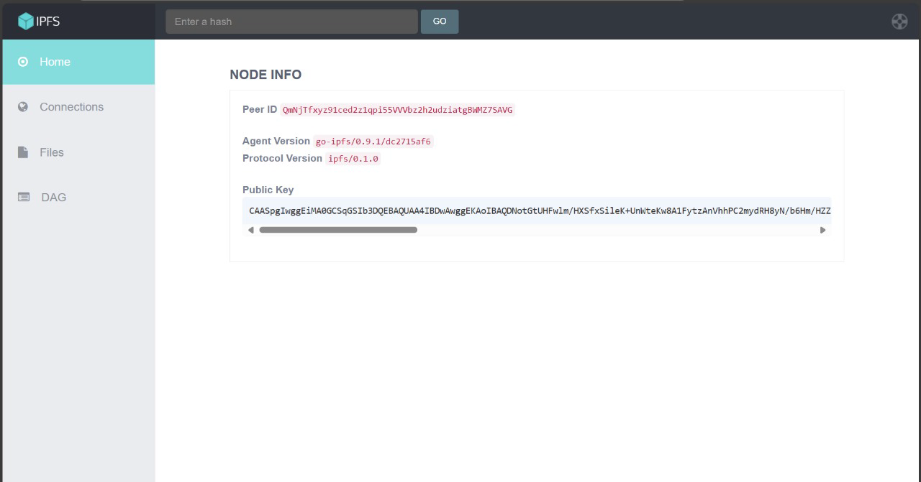
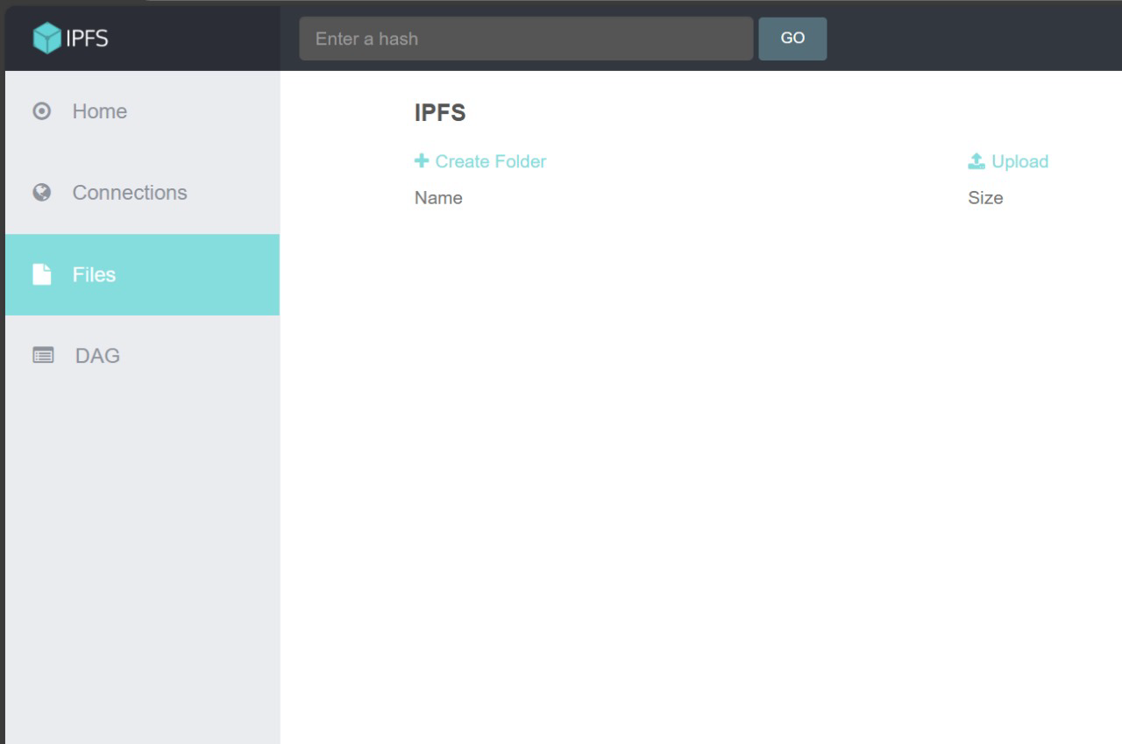
IPFS:

Slide 15
techniques
Smart Contract Development: Writing and deploying smart contracts using Solidity to handle energy trading transactions.
Consensus Mechanism: Implementing IBFT for transaction validation.
Tokenization: Representing energy units as tokens on the blockchain for trading.
Private Transactions: Utilizing Quorum’s privacy features to keep transaction details confidential.
-Event Handling: Using Web3.js to listen for smart contract events and update the application state accordingly.
Data Encryption: Encrypting sensitive transaction data to ensure privacy and security.

Slide 16
Progress Achieved So Far:
1. Microgrid Template Setup: Successfully set up the microgrid simulation template in MATLAB/Simulink. Included key components such as renewable energy sources (e.g., solar PV), loads, and storage systems.
2. Framework Development: Started building the simulation framework to model energy generation, load profiles, and energy flow. 3. Tool Identification: Identified necessary MATLAB tools, including the Power System Toolbox, Simscape, and Optimization Toolbox.
Project Progress

Slide 17
Analysis of Partial Results:
1. Current Status: The smart grid simulation framework is in the initial setup phase, and no partial results are available yet.
2. Planned Analysis: Once the simulation progresses, the following analyses will be performed:
Energy Distribution: Efficiency of energy allocation among peers. Trading Patterns: Insights into energy demand, supply, and trading prices. Cost Analysis: Savings achieved through P2P trading compared to traditional grid energy.
System Performance: Stability and reliability of the microgrid under different scenarios.
Analysis of Partial Results

Slide 18
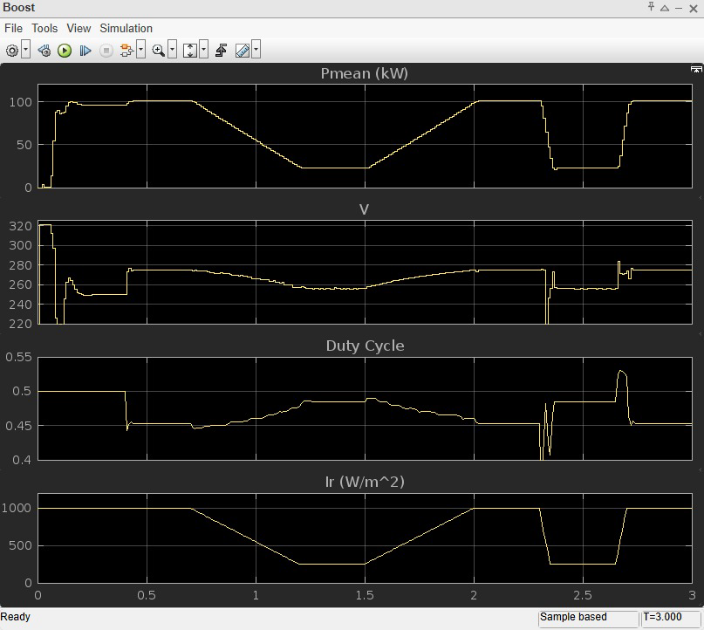

Slide 19
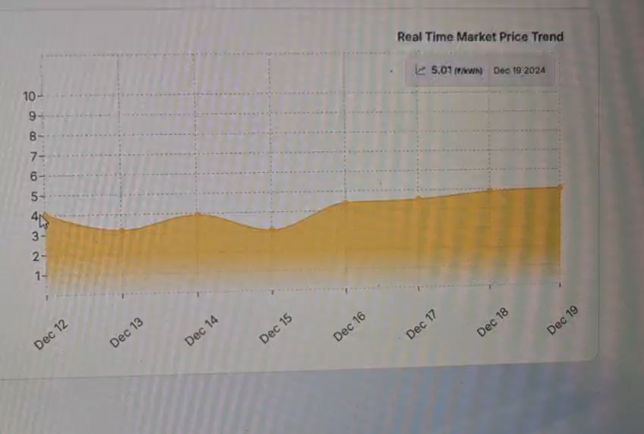
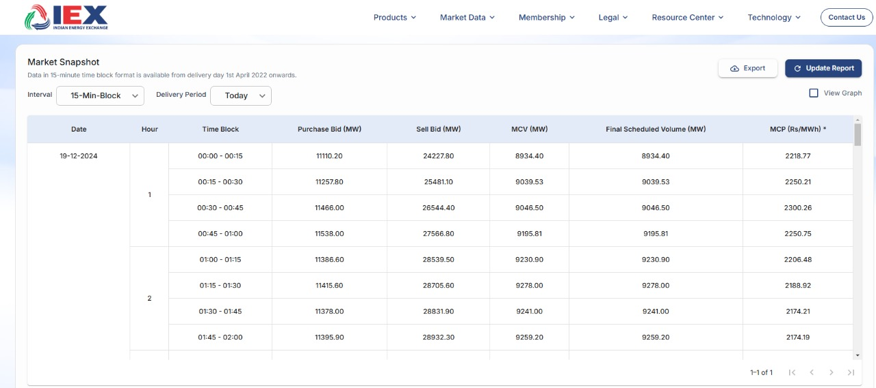
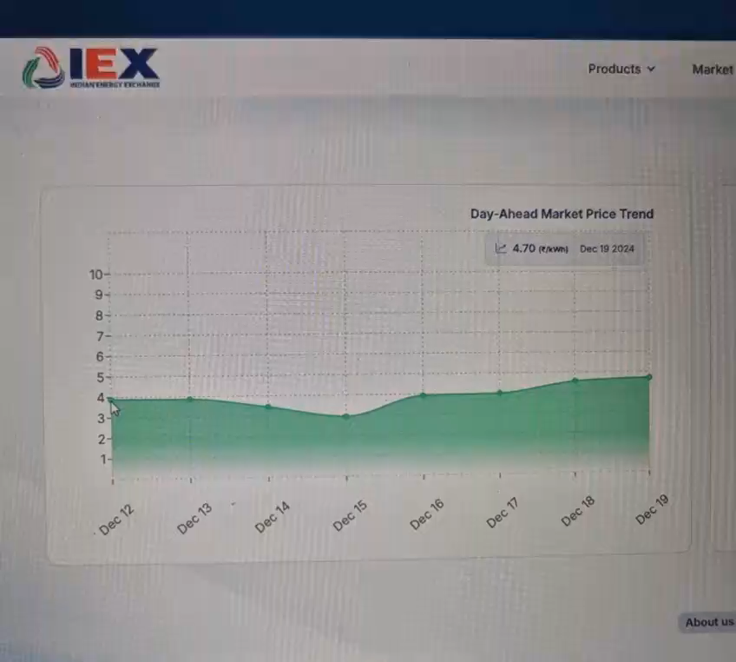
FINANCIAL MODEL
Official data taken from the IEX website

Slide 20
Deliverables and Outcomes
Expected Outcomes: Identification of optimal trading strategies to maximize cost savings for prosumers and consumers.
Improved energy utilization and reduced dependence on centralized grids. Insights into the scalability of the P2P trading model for larger communities.

Slide 21
Future work
Established simulation of smart grid by integrating all aspects and elements in a typical smart grid
Creation of efficient block chain model by improving code and establishing a GUI for users to enable energy trading.
Implementation of blockchain code into matlab.
Testing the working model and efficiency providing graphs and statistics to reflect efficiency of model.

Slide 22

Conclusion
Identification of template for simulation model, mapping all aspects of smart grid .
Efficient Model for blockchain analysed and optimised for use case.
we are able to map out a work case smart grid for simulation of energy distribution which will be made functional to exibit typical consumer-prosumer model.
Efficient blockchain model will be enabled synonymously with the smart grid to showcase energy trading with precise data regarding energy distribution and pricing.

Slide 23
contributions
Anwesha Mohapatra – blockchain development
Himpana S S – smart grid simulation and mapping of elements
Sivani Vemuri - creation analysation of financial model
Dummu Nishitha – blockchain code analysation and compilation
Deepana V – integrating block chain environment with Simulink model

Slide 24


